Slide 1

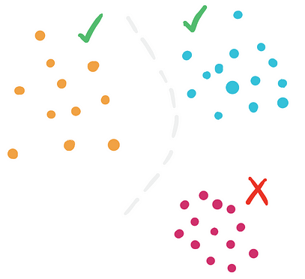
Envisioning Outlier Exposure by Large Language Models for
Out-of-Distribution Detection
Authors: Chentao Cao, Zhun Zhong, Zhanke Zhou, Yang Liu, Tongliang Liu, Bo Han

Slide 2
2
Introduction
Why Matters?
What Problems?
Key Question?
Real-world systems often face unfamiliar OOD inputs, risking unreliable or unsafe predictions
Rely only on visual pattern
Perform poorly on hard OOD samples
Limited access to a different label space
Is it possible to generate the potential outlier class labels
for OOD detection without access
to test-time data?

Slide 3
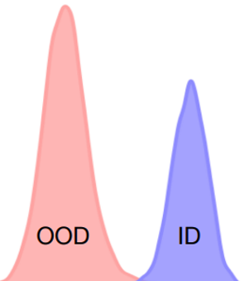


3
Background
Visual Language Model
Zero-shot OOD Detection
Large Language Model
Trained on 400M image–text pairs
Image Encoder & Text Encoder
similarity is computed between embeddings
No retraining required on any unseen ID data
Existing zero-shot OOD detection rely only on closed-set ID labels
Trained on massive text dataset
Understand & Generate Natural Language
covering many knowledge domains

Slide 4
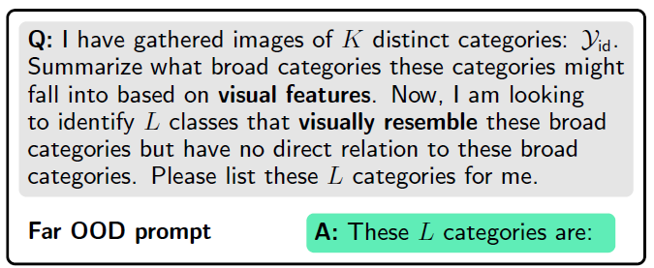
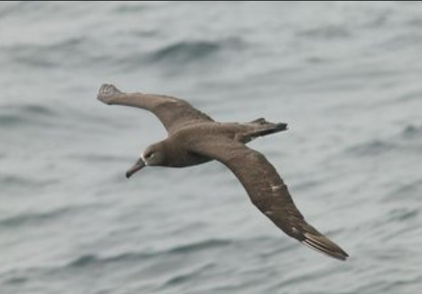
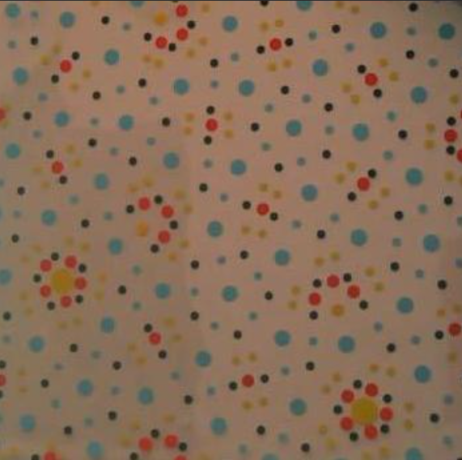
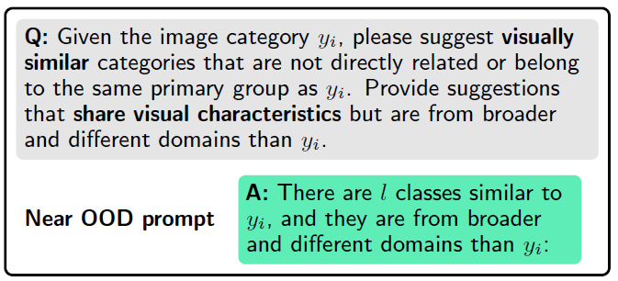
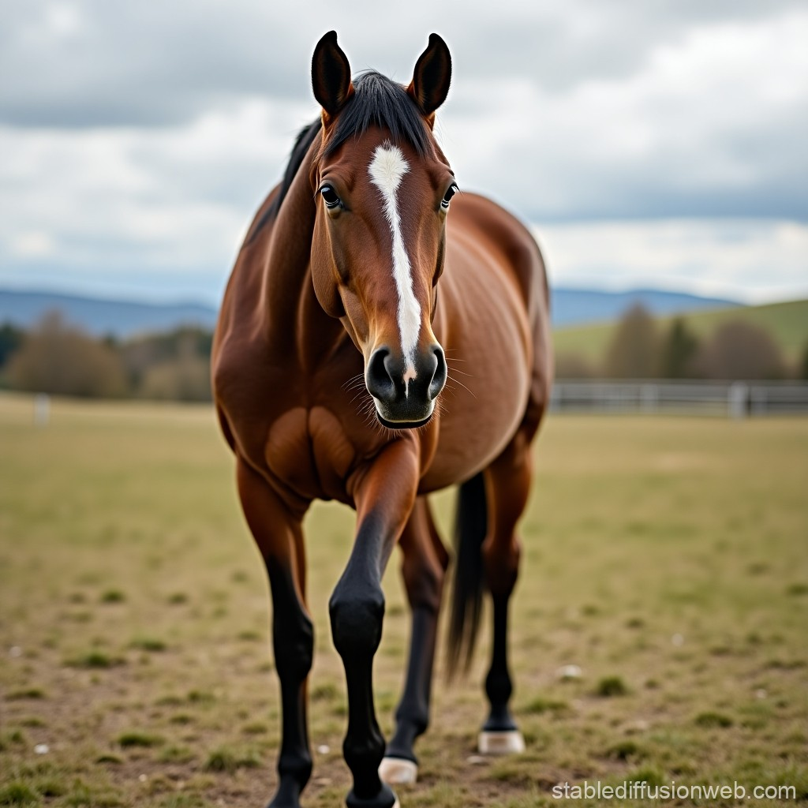
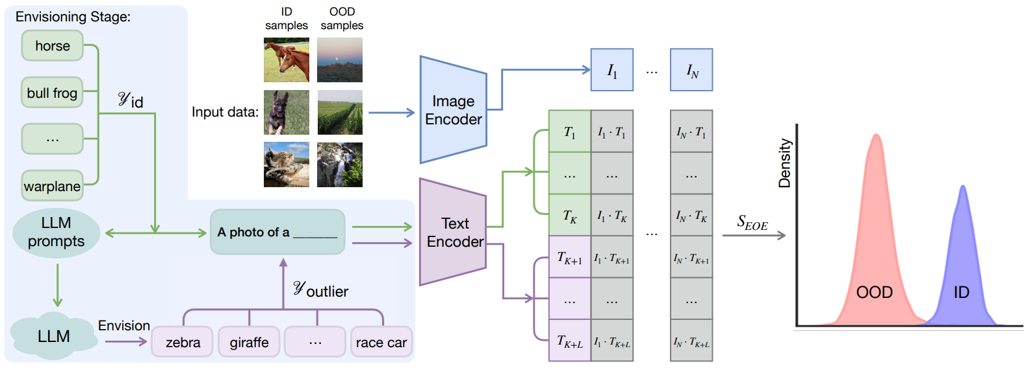
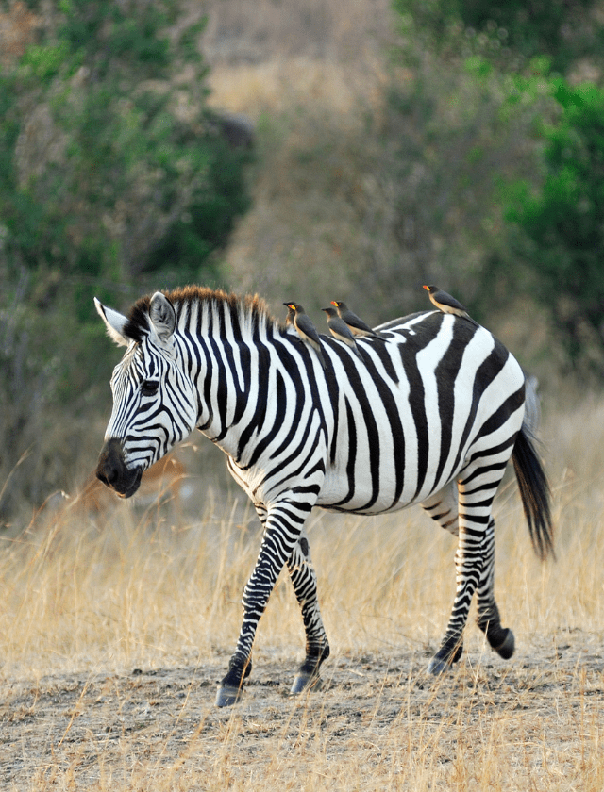
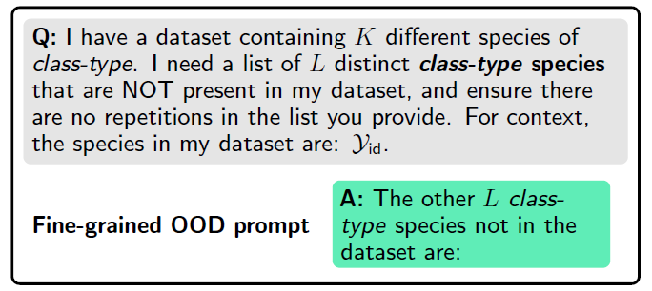
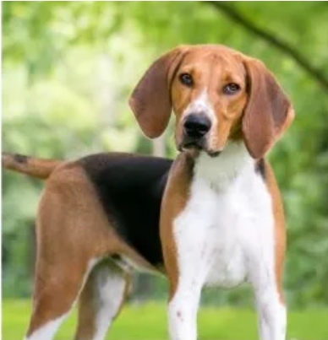
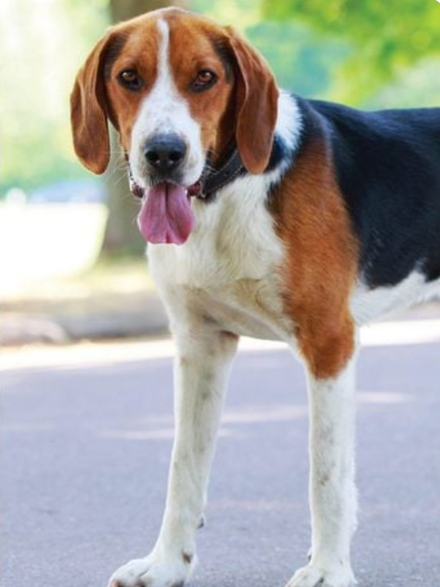
4
Method
1. Envisioning Stage

Slide 5
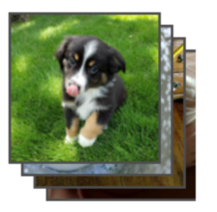
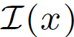
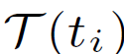
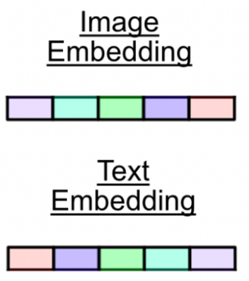
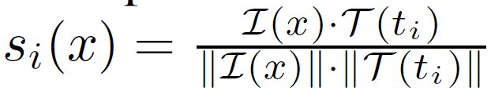
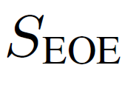
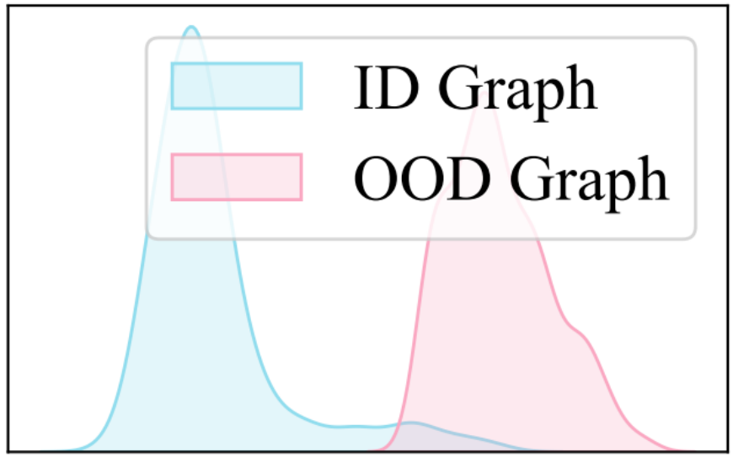
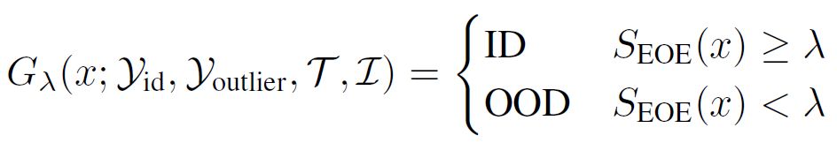
5
Method
1. Image & Text Embedding
2. Detection Stage
2. Compute Label-Wise Similarity
3. Compute OOD Detection Score
4. Final Decision Rule

Slide 6

6
Experiments-Far
Used
ID
Datasets | Classes | Domain | Images
CUB-200-2011 | 200 | Bird species | 11k
Stanford Cars | 196 | Car models | 16k
Food-101 | 101 | Food categories | 101k
Oxford-IIIT Pet | 37 | Dog & cat | 7k
ImageNet-1K | 1000 | General object | 1.4 million
Settings | Type
LLM | GPT-3.5-Turbo
CLIP | ViT-16/B
No. Labels | 50,100,300
β | 0.25 (default),0.75
Method | EOE, MCM
OOD
Datasets | Classes | Domain | Images
iNaturalist | 5k-10k | Plant/Animals | 0.8-3.3 million
SUN | 397 | Scenes | 108k
Places | 400 | Scenes/Environment | 10 million
Texture | 47 | Texture Attributes | 5k

Slide 7
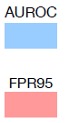
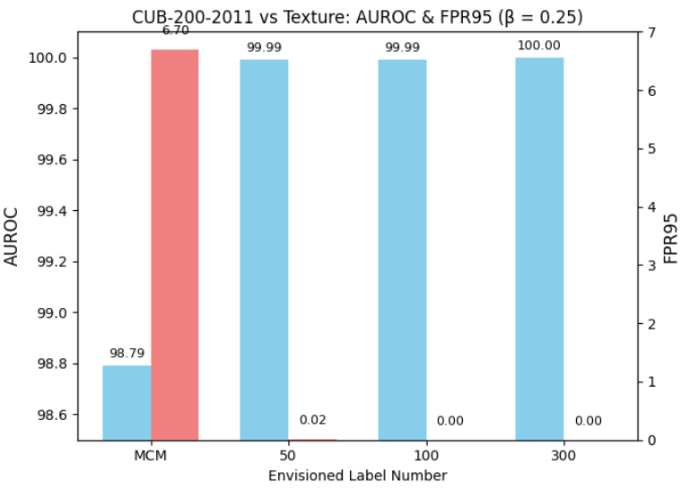
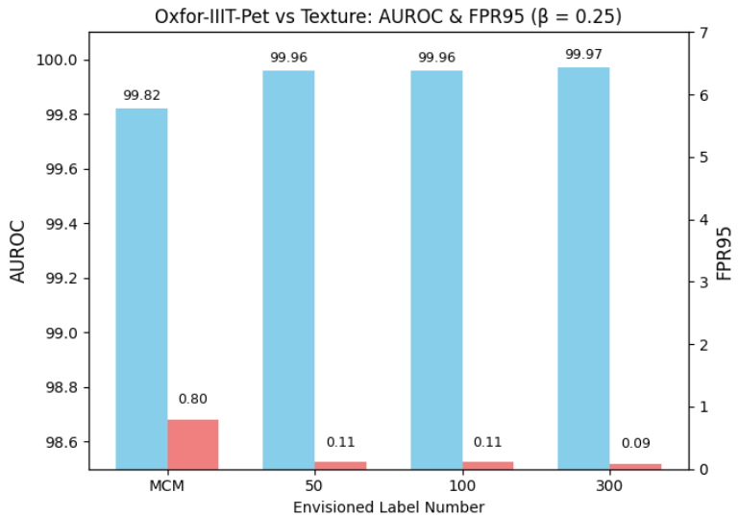
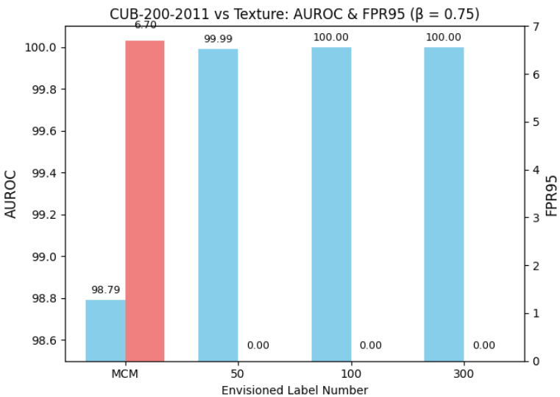
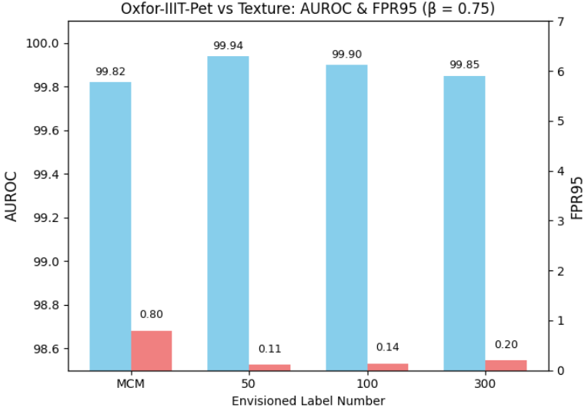
7
Results-Far
ID Dataset | Envisioned Label Number | Beta | OOD Dataset : Texture
 |  |  | FPR95 | AUROC
CUB-200-2011 | 0 (MCM) | - | 6.70 | 98.79
 | 50 | 0.25 | 0.02 | 99.99
 |  | 0.75 | 0.00 | 99.99
 | 100 | 0.25 | 0.00 | 99.99
 |  | 0.75 | 0.00 | 100.00
 | 300 | 0.25 | 0.00 | 100.00
 |  | 0.75 | 0.00 | 100.00
Oxford-IIIT Pet | 0 (MCM) | - | 0.80 | 99.82
 | 50 | 0.25 | 0.11 | 99.96
 |  | 0.75 | 0.11 | 99.94
 | 100 | 0.25 | 0.11 | 99.96
 |  | 0.75 | 0.14 | 99.90
 | 300 | 0.25 | 0.09 | 99.97
 |  | 0.75 | 0.20 | 99.85

Slide 8
8
Experiments-Near
Used
Original (ID⇔OOD)
Datasets | Classes | Domain
ImageNet-10 | 10 | General Object
ImageNet-20 | 20 | General Object
Settings | Type
LLM | GPT-3.5-Turbo
CLIP | ViT-16/B
No. Labels (K=Class) | 1*K, 3*K, 10*K
β | 0.25 (default) ,0.75
Method | EOE, MCM
Experiment (ID⇔OOD)
Datasets | Classes | Domain
CIFAR-10 | 10 | General Object
CIFAR-100 | 20 Superclass | General Object

Slide 9
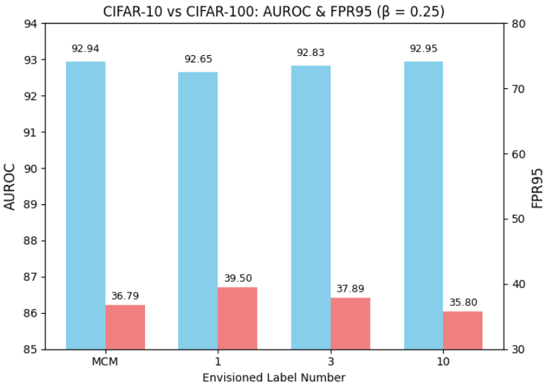
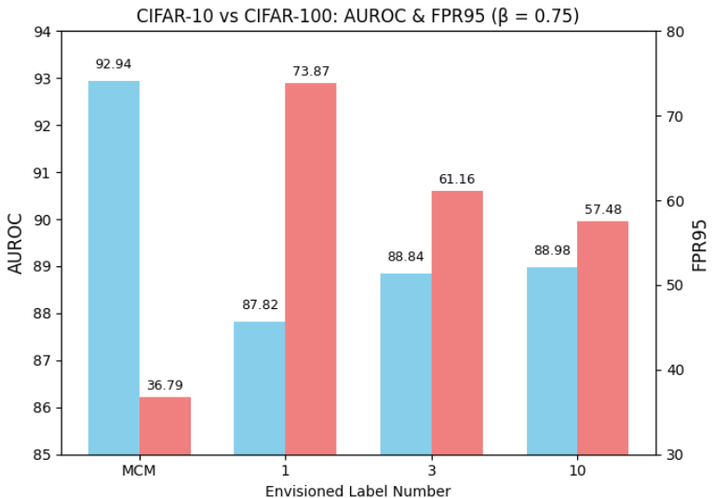
9
Results-Near
ID Dataset | Envisioned Label Number | Beta | OOD Dataset : CIFAR-100
 |  |  | FPR95 | AUROC
CIFAR-10 | 0 (MCM) | - | 36.79 | 92.94
 | 1*K | 0.25 | 39.50 | 92.65
 |  | 0.75 | 73.87 | 87.82
 | 3*K | 0.25 | 37.89 | 92.83
 |  | 0.75 | 61.16 | 88.84
 | 10*K | 0.25 | 35.80 | 92.95
 |  | 0.75 | 57.48 | 88.98

Slide 10
10
Experiments-FineGrained
Used
Original
(ID-OOD)
Datasets | Classes | Domain
CUB-100 | 100-100 | Bird species
Stanford Cars | 98-98 | Car models
Food-101 | 50-51 | Food categories
Oxford-IIIT Pet | 19-18 | Dog & cat
Settings | Type
LLM | GPT-3.5-Turbo
CLIP | ViT-16/B
No. Labels | 50,100,300
β | 0.25 (default),0.75
Method | EOE, MCM
Experiment (ID-OOD)
Datasets | Classes | Domain
CUB-100 | 100-100 | Bird species
Oxford-IIIT Pet | 19-18 | Dog & cat

Slide 11
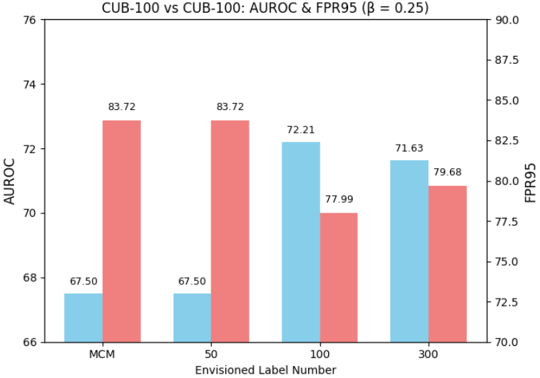
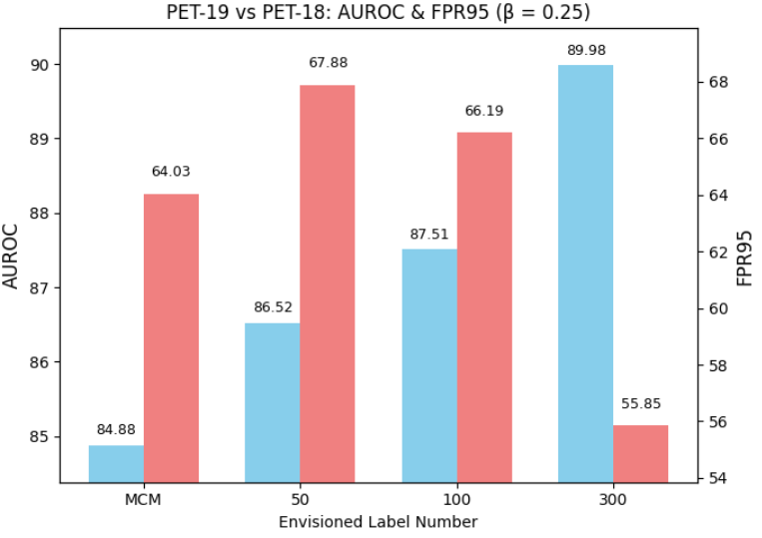
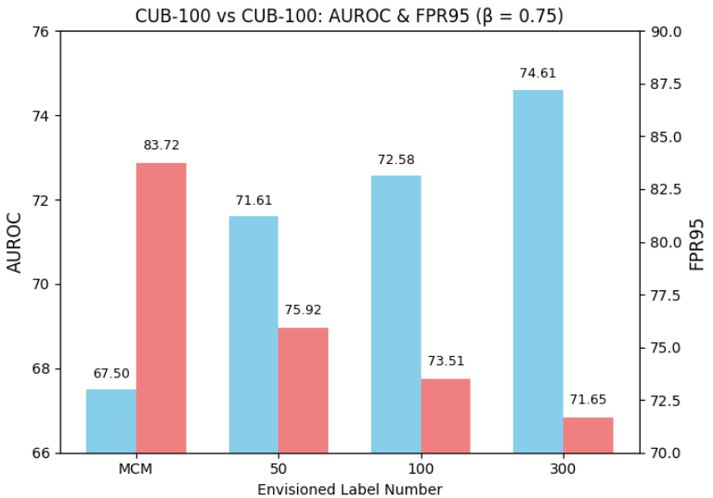
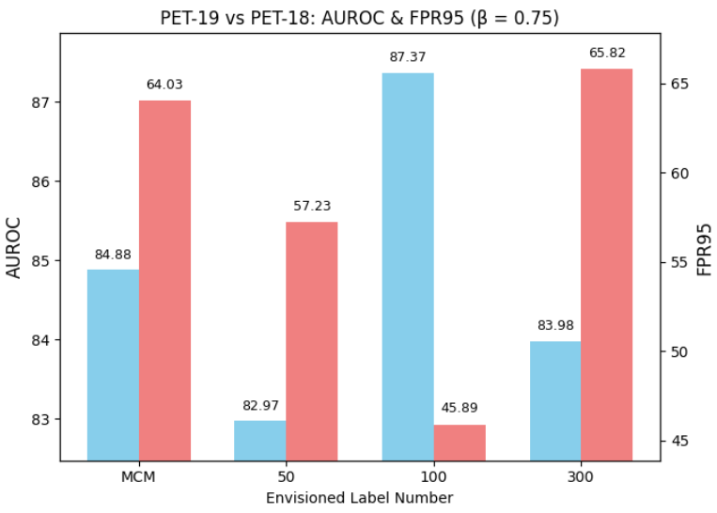
11
Results-FineGrained
ID Dataset | Envisioned Label Number | Beta | OOD Dataset : CUB-100, PET-18
 |  |  | FPR95 | AUROC
CUB-100 | 0 (MCM) | - | 83.72 | 67.50
 | 50 | 0.25 | 83.72 | 67.50
 |  | 0.75 | 75.92 | 71.61
 | 100 | 0.25 | 77.99 | 72.21
 |  | 0.75 | 73.51 | 72.58
 | 300 | 0.25 | 79.68 | 71.63
 |  | 0.75 | 71.65 | 74.61
PET-19 | 0 (MCM) | - | 64.03 | 84.88
 | 50 | 0.25 | 67.88 | 86.52
 |  | 0.75 | 57.23 | 82.97
 | 100 | 0.25 | 66.19 | 87.51
 |  | 0.75 | 45.89 | 87.37
 | 300 | 0.25 | 55.85 | 89.98
 |  | 0.75 | 65.82 | 83.98

Slide 12
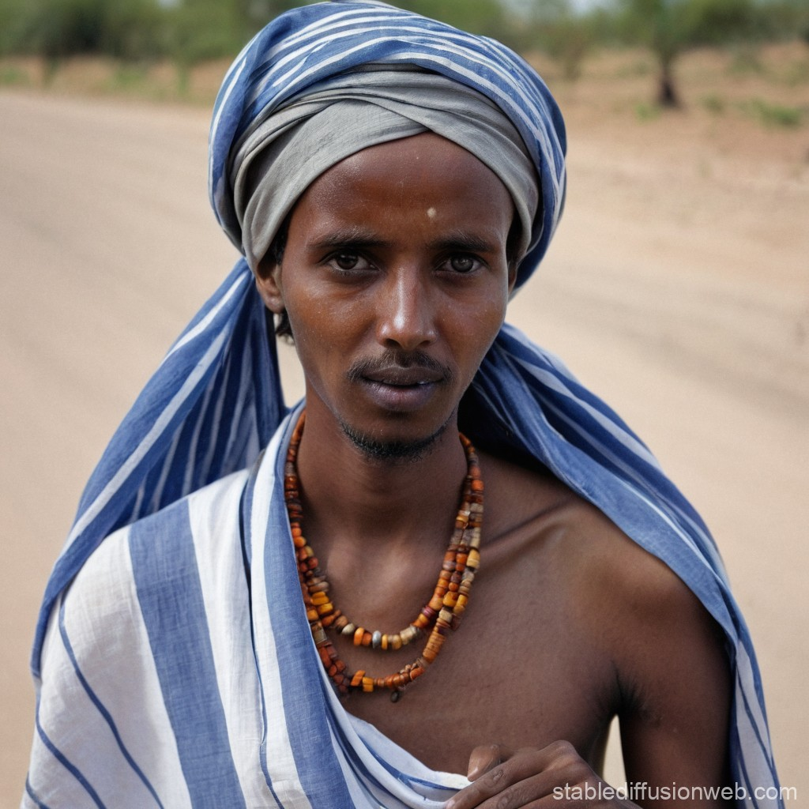
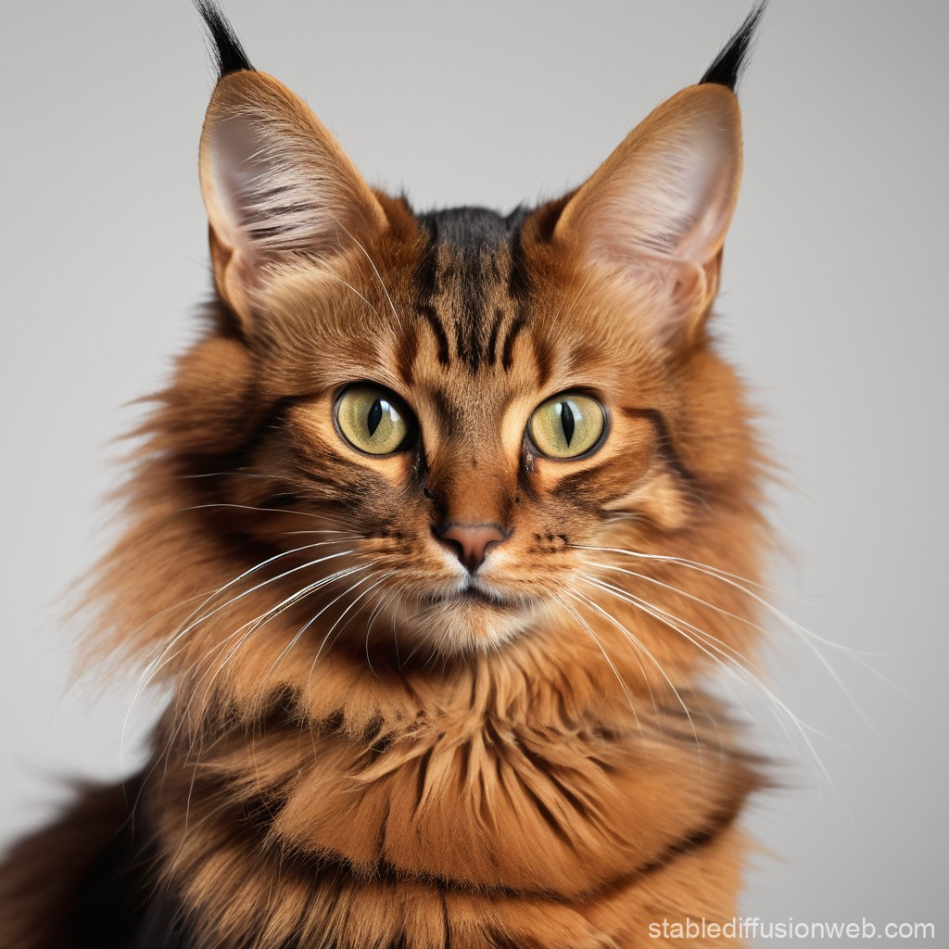
12
Additional Experiment
1. Envision OOD labels using LLM
"You are a fine-grained classification assistant.
When given a [class-type] species name, reply with exactly one known synonym or scientific name or name in other language.
If no widely used alternative exists, reply with the original label and do not return none. Only return the name. Do not include explanations, punctuation, or prefixes..."
Generated OOD:
Schapendoes
Saluki
Borzoi
Somali
2. For each generated label, fetch synonym
Synonym OOD:
dutch sheepdog
persian greyhound
russian wolfhound
somali cat
Datasets | Classes | Domain
CUB-100 | 100-100 | General Object
Oxford-IIIT Pet | 19-18 | Dog & Cat
3. Filter and remove duplicate
Settings | Type
LLM | GPT-3.5-Turbo
CLIP | ViT-16/B
No. Labels | 50,100,300
β | 0.25 (default)
Method | EOE
4. Final OOD list: original + synonyms

Slide 13
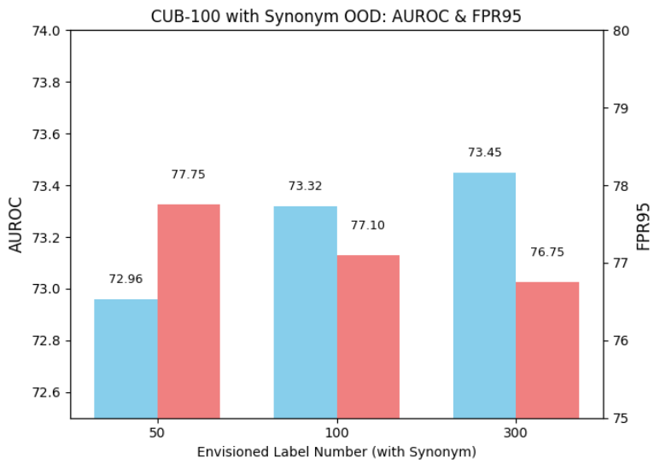
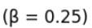
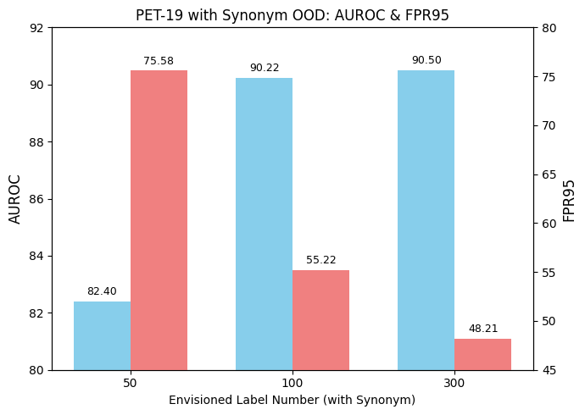
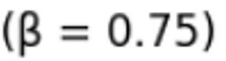
13
Results-Experiment
ID Dataset | Envisioned Label Number | Without Synonym OOD |  | With Synonym OOD
 |  | FPR95 | AUROC | FPR95 | AUROC
CUB-100 | 50 | 83.72 | 67.50 | 77.75 | 72.96
 | 100 | 77.99 | 72.21 | 77.10 | 73.32
 | 300 | 79.68 | 71.63 | 76.75 | 73.45
PET-19 | 50 | 67.88 | 86.52 | 75.58 | 82.40
 | 100 | 66.19 | 87.51 | 55.22 | 90.22
 | 300 | 55.85 | 89.98 | 48.21 | 90.50

Slide 14

14
Conclusion
Zero-Shot Paradigm
This paper a novel zero-shot OOD detection approach that requires no real or auxiliary OOD data.
01
Scalability
LLM-Driven Outlier
Achieves state-of-the-art performance across multiple benchmarks and scales effectively to large datasets like ImageNet-1K
Leverages expert knowledge of LLMs to generate visually plausible outlier classes.
05
02
Novel Score Function
04
03
Generalizable Prompt Design
Introduces a new scoring function that incorporates a penalty term for potential outliers.
Three task-agnostic LLM prompts are proposed, enabling EOE to handle far, near, and fine-grained OOD detection tasks.

Slide 15
15
Future Work
01
02
Improve LLM Understanding of ID Categories
Unify Prompt Strategy Across OOD Task
1. Check: Ask if it understands
2. Fallback: Use MCM if it does not
3. Teach: Provide visual descriptions via in-context learning
Use a unified prompt to handle all OOD types, reducing reliance on task-specific tuning.

Slide 16
Thank You

Slide 17
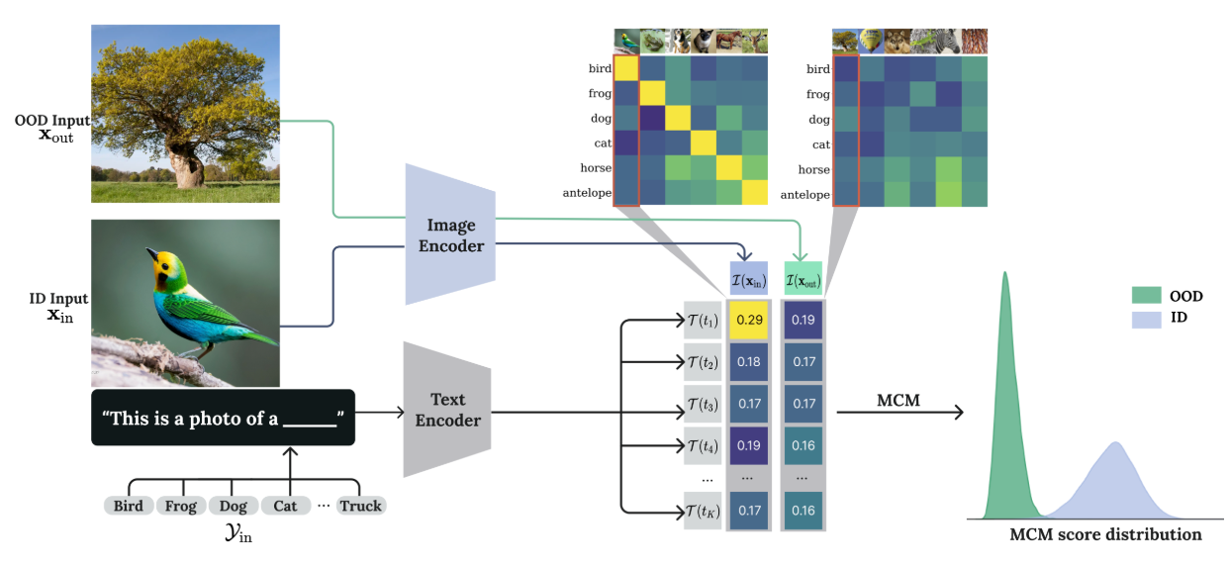
17
Backup

Slide 18
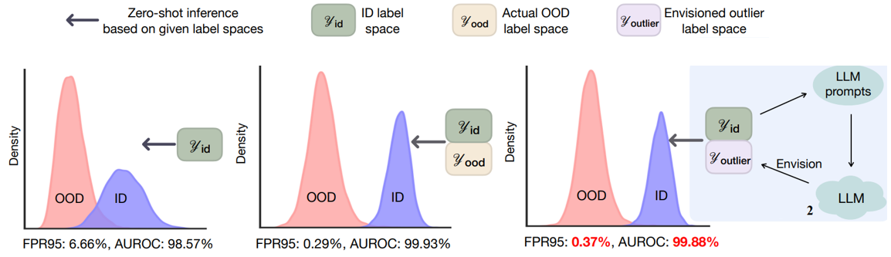
Backup
Notes:
Normalize scores across all possible classes (so they sum to 1)
Interpret scores as relative probabilities
Enable thresholding and ranking with better separation

Slide 19
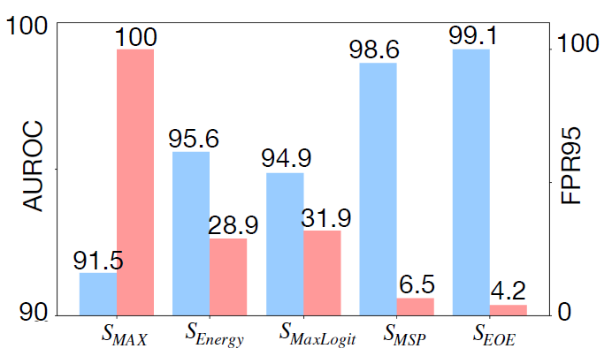
19
Backup
Near-OOD task
ID dataset: ImageNet-10; OOD
dataset: ImageNet-20.

Slide 20
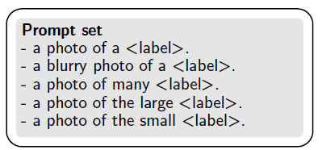
Backup

Slide 21
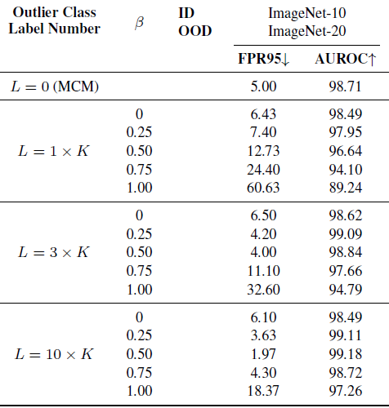
Backup

Slide 22
1. Generate Outlier Class Labels using LLM
2. Retrieve One Semantic Variant per Label via LLM Prompt
3. Filter Duplicates and Redundant Labels
4. Final OOD Label Set (Original Labels + Unique Semantic Variants)

